Slide 1
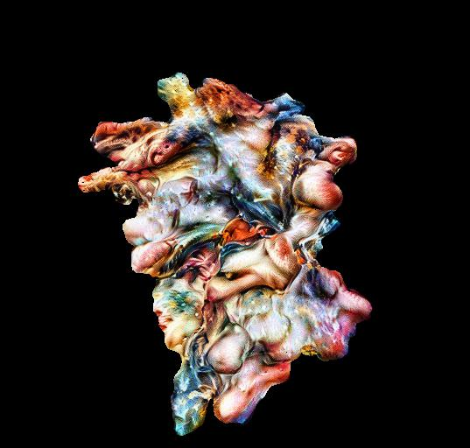

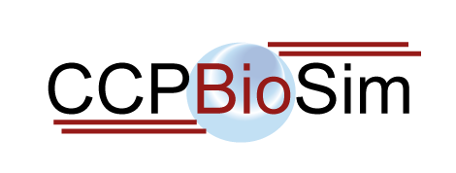
The Art of Molecular Dynamics
Rob Arbon (@bertiearbon)
Data Scientist @ Jean Golding Institute
Thursday 25th June 13:00 – 17:00.

Slide 2
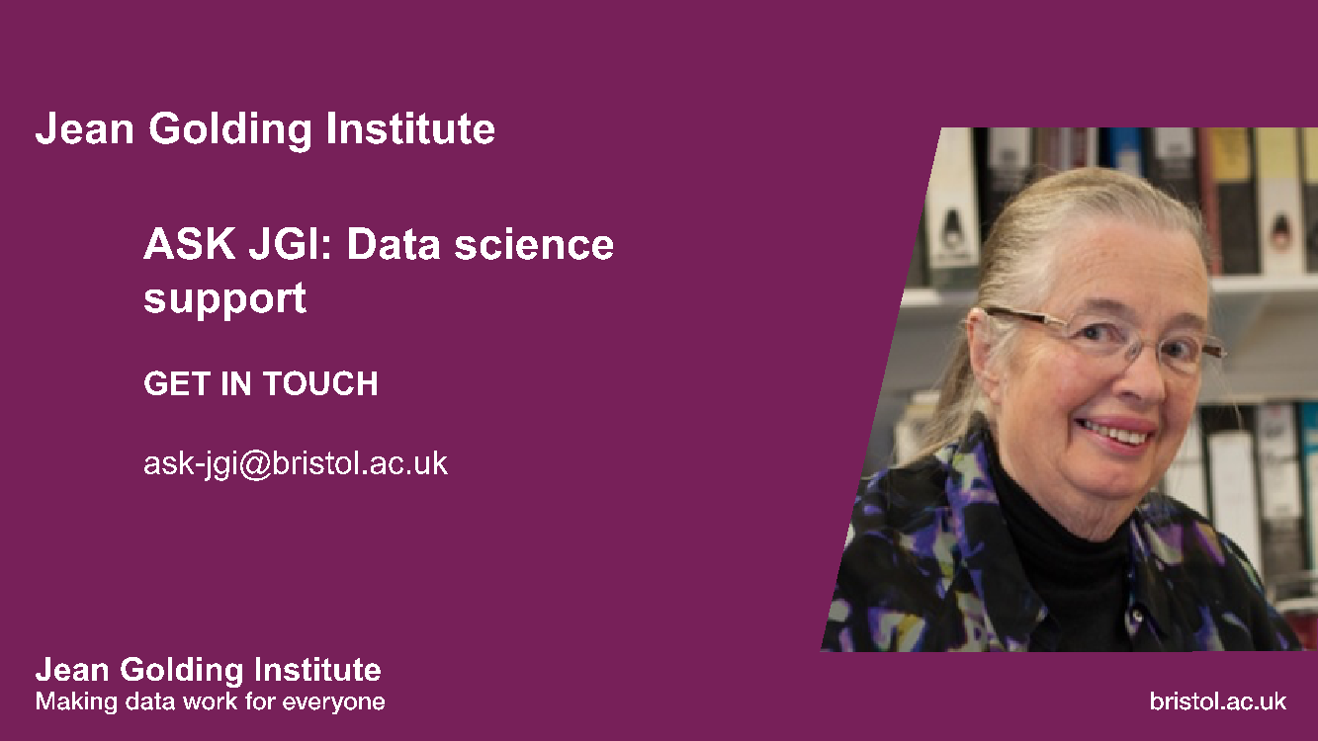

Slide 3
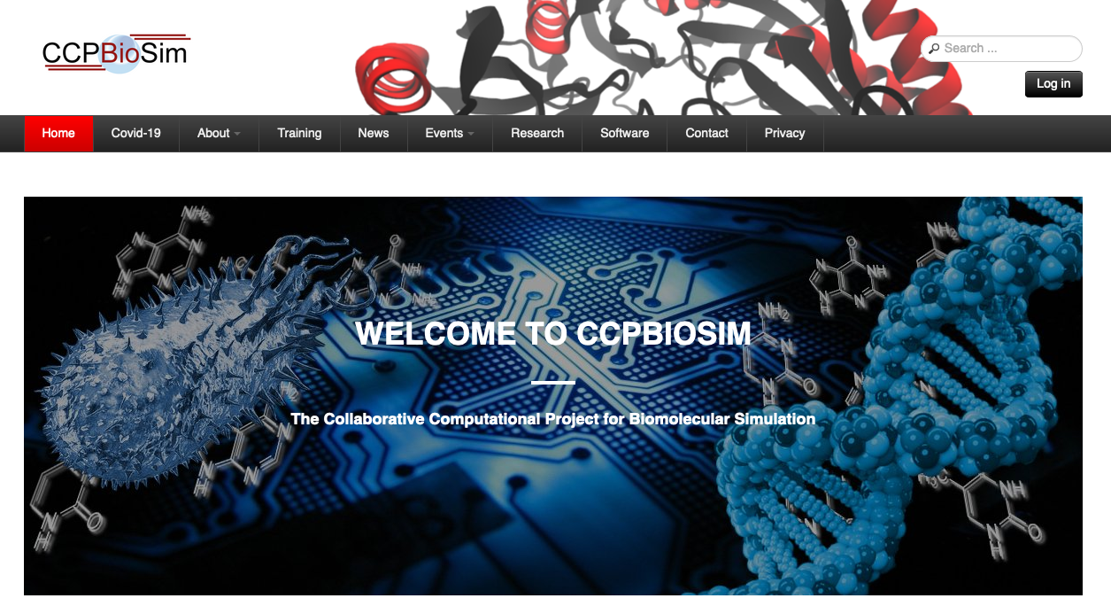

Slide 4
Itinerary
13:00 – 13:15: Introduction
13:15 – 13:30: Google Colab and Google Drive
13:30 – 14:30: Python and images
14:30 – 15:00: Break
15:00 – 15:45: Deep learning and convolutional neural networks
15:45 – 17:00: Style Transfer

Slide 5
Course overview

Slide 6
Who are we?
Rob Arbon
@bertiearbon
PhD student with Adrian Mulholland and David Glowacki
Data scientist at Jean Golding Institute
Dasha Shchepanovska
PhD student with David Glowacki

Slide 7
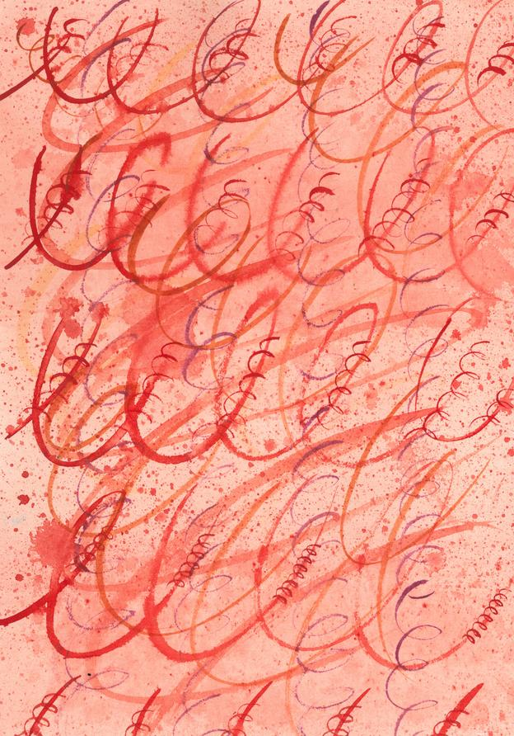
Project timeline
Barbican, London, Autumn 2017
Seed week focusing on collaborative practice between artists and scientists following on from danceroom Spectroscopy art-science collaboration https://www.danceroom-spec.com/people/
Suggestion by David Glowacki to use new ‘Algorithm of Artistic Style’ (Gatys, 2016) in collaboration with artist Gemma Anderson in novel representations of protein motions http://www.gemma-anderson.co.uk/
Metastable impressions, Bristol, Summer 2019
Pete Bennett, Alex Jones, Rob Arbon, George Holloway, won JGI Seed Corn funds to develop Metastable Impressions
data-inspired string quartet composed by George Holloway http://georgehollowaycomposer.com/
Performed by Ligeti Quartet https://ligetiquartet.com/
Simulation data from John Chodera http://www.choderalab.org/ and Rafal Wiewiora
HPC support from Mike O’Connor and David Glowacki
'Helix’ by Gemma Anderson

Slide 8
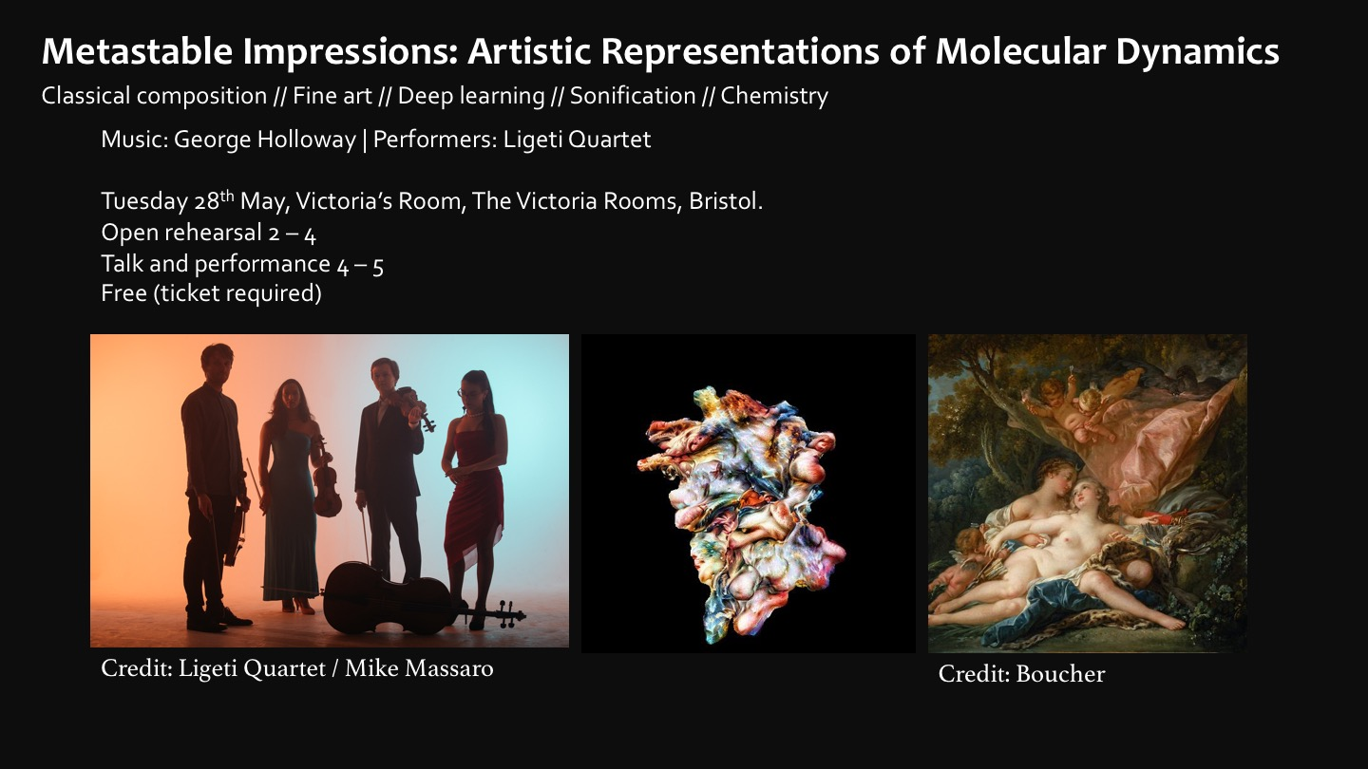

Metastable impressions
https://youtu.be/zmXO6AZMOYU?t=3818

Slide 9
Google Colab and Google Drive

Slide 10
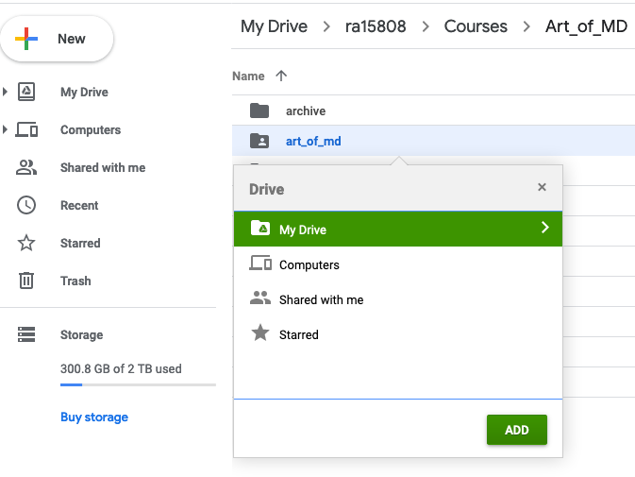
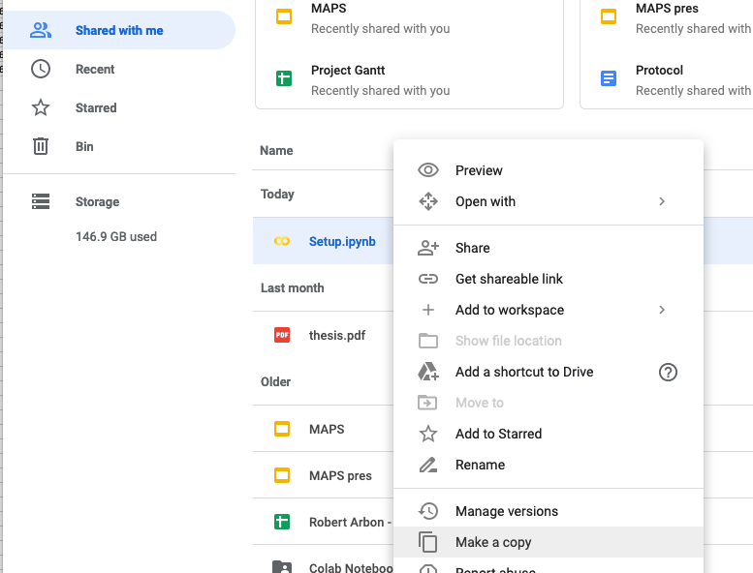
Google Drive
Make a copy of Setup.ipynb
shift+z add art_of_md

Slide 11
Google Drive overview:
images/ - content, style, output images
notebooks/ - Google colab notebooks
scripts/ - PyMol scripts used to create content images
slides/ - these slides
structures/ - PDBs used to create content images

Slide 12
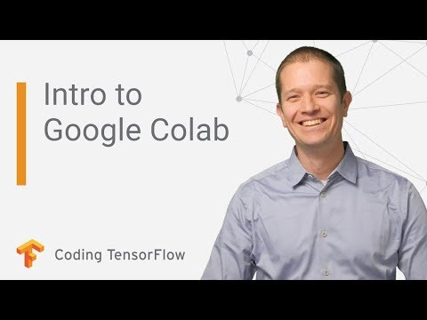
Google Colab
https://www.youtube.com/watch?v=inN8seMm7UI

Slide 13
Python and Images

Slide 14
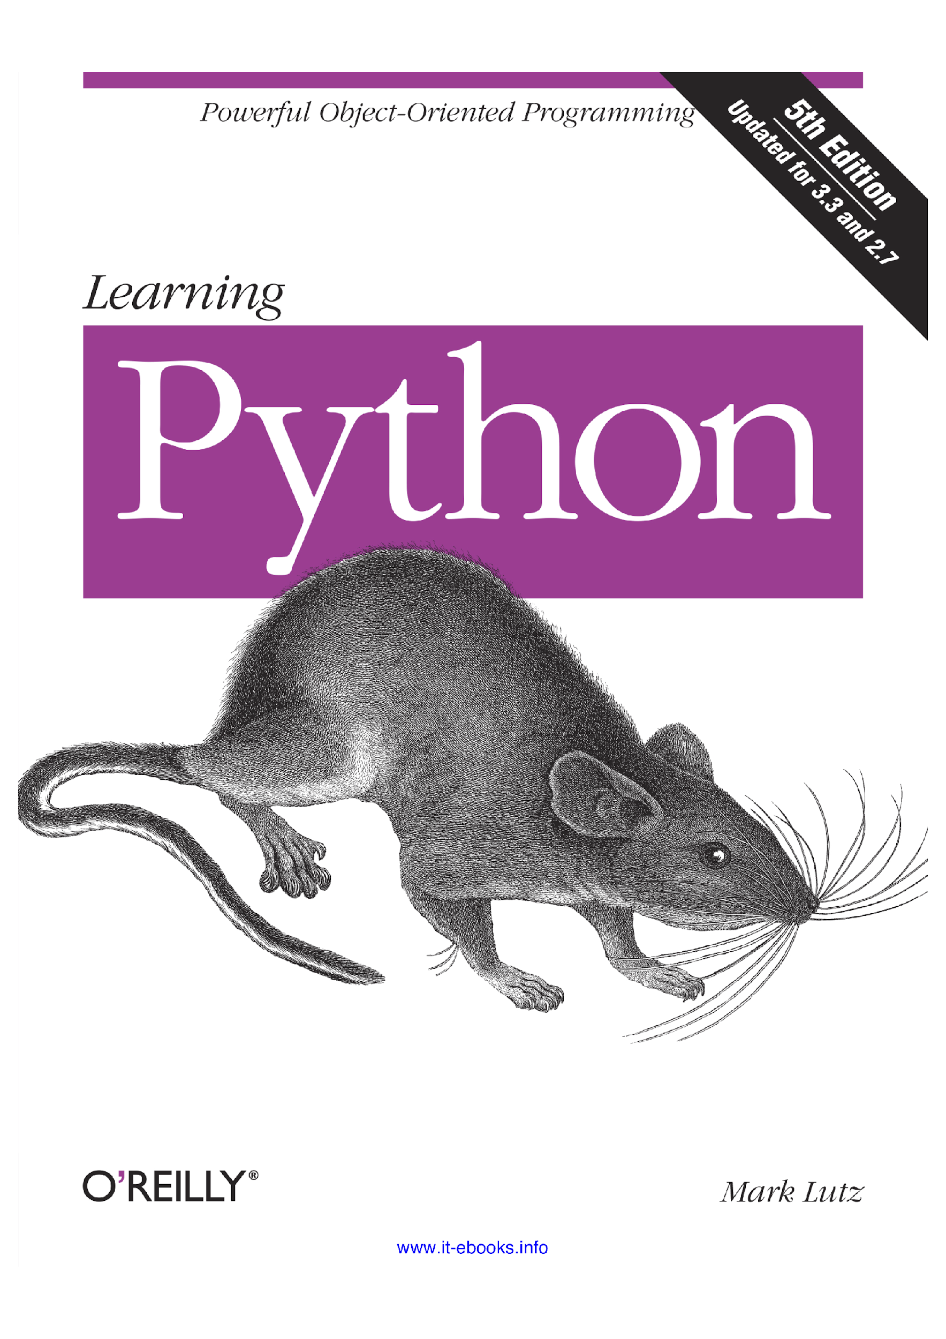
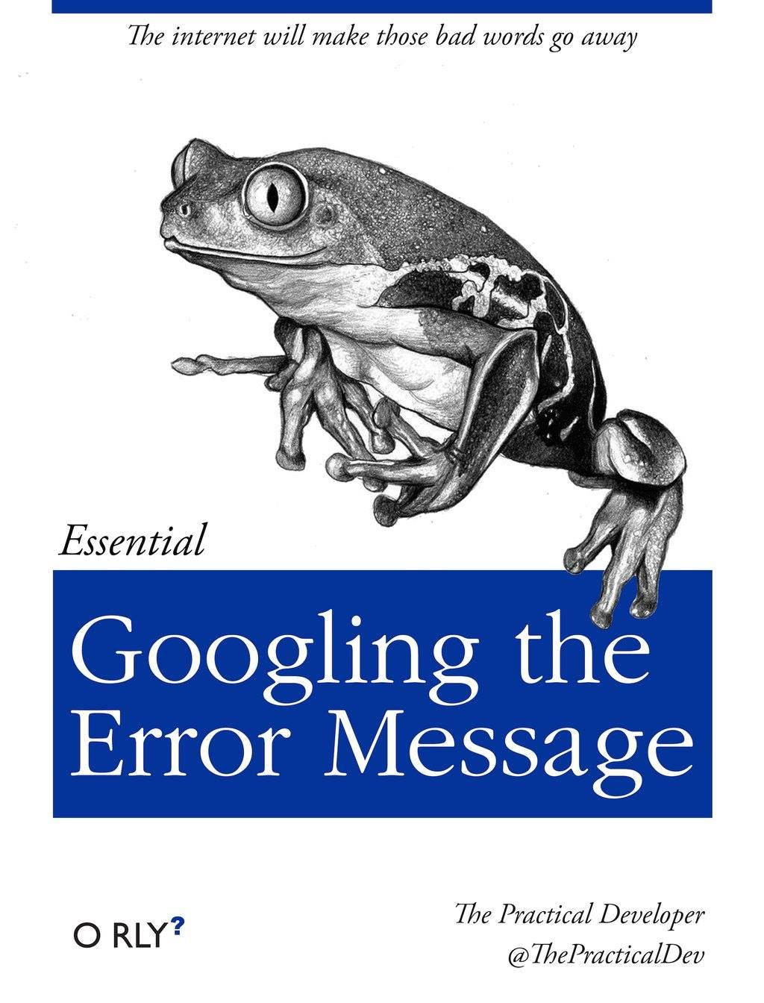
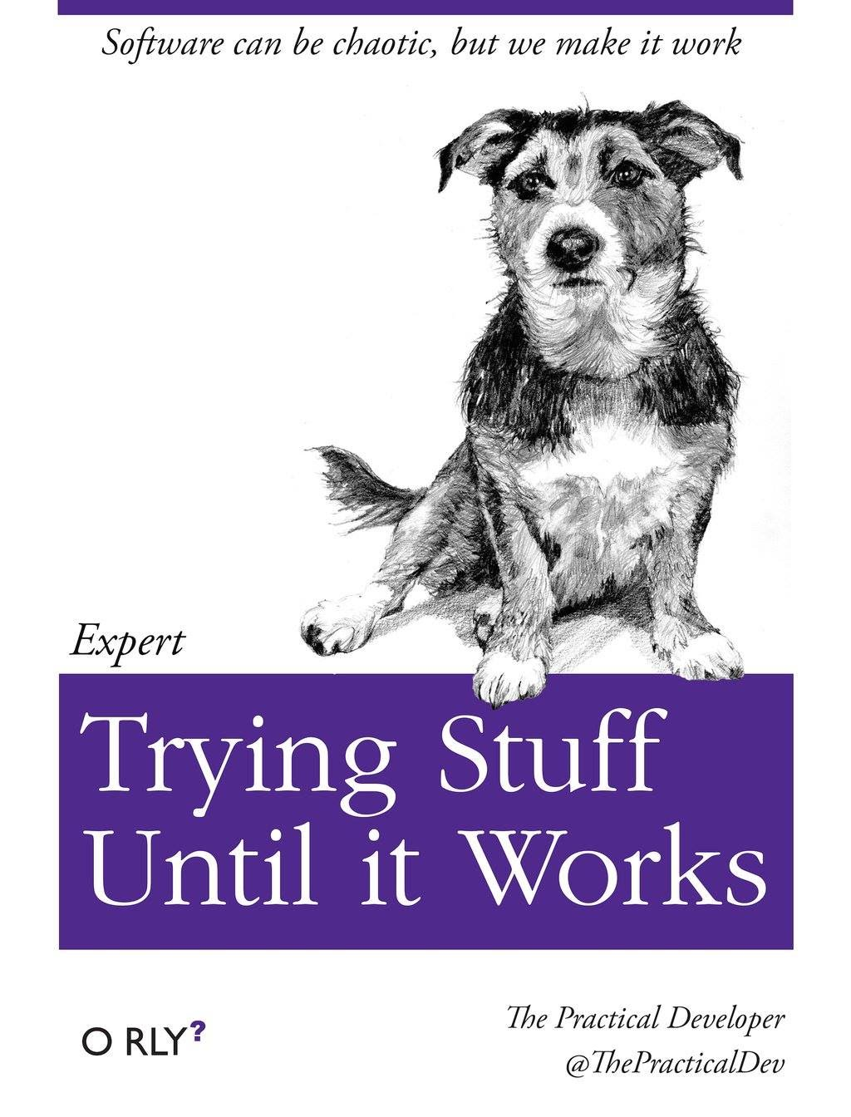
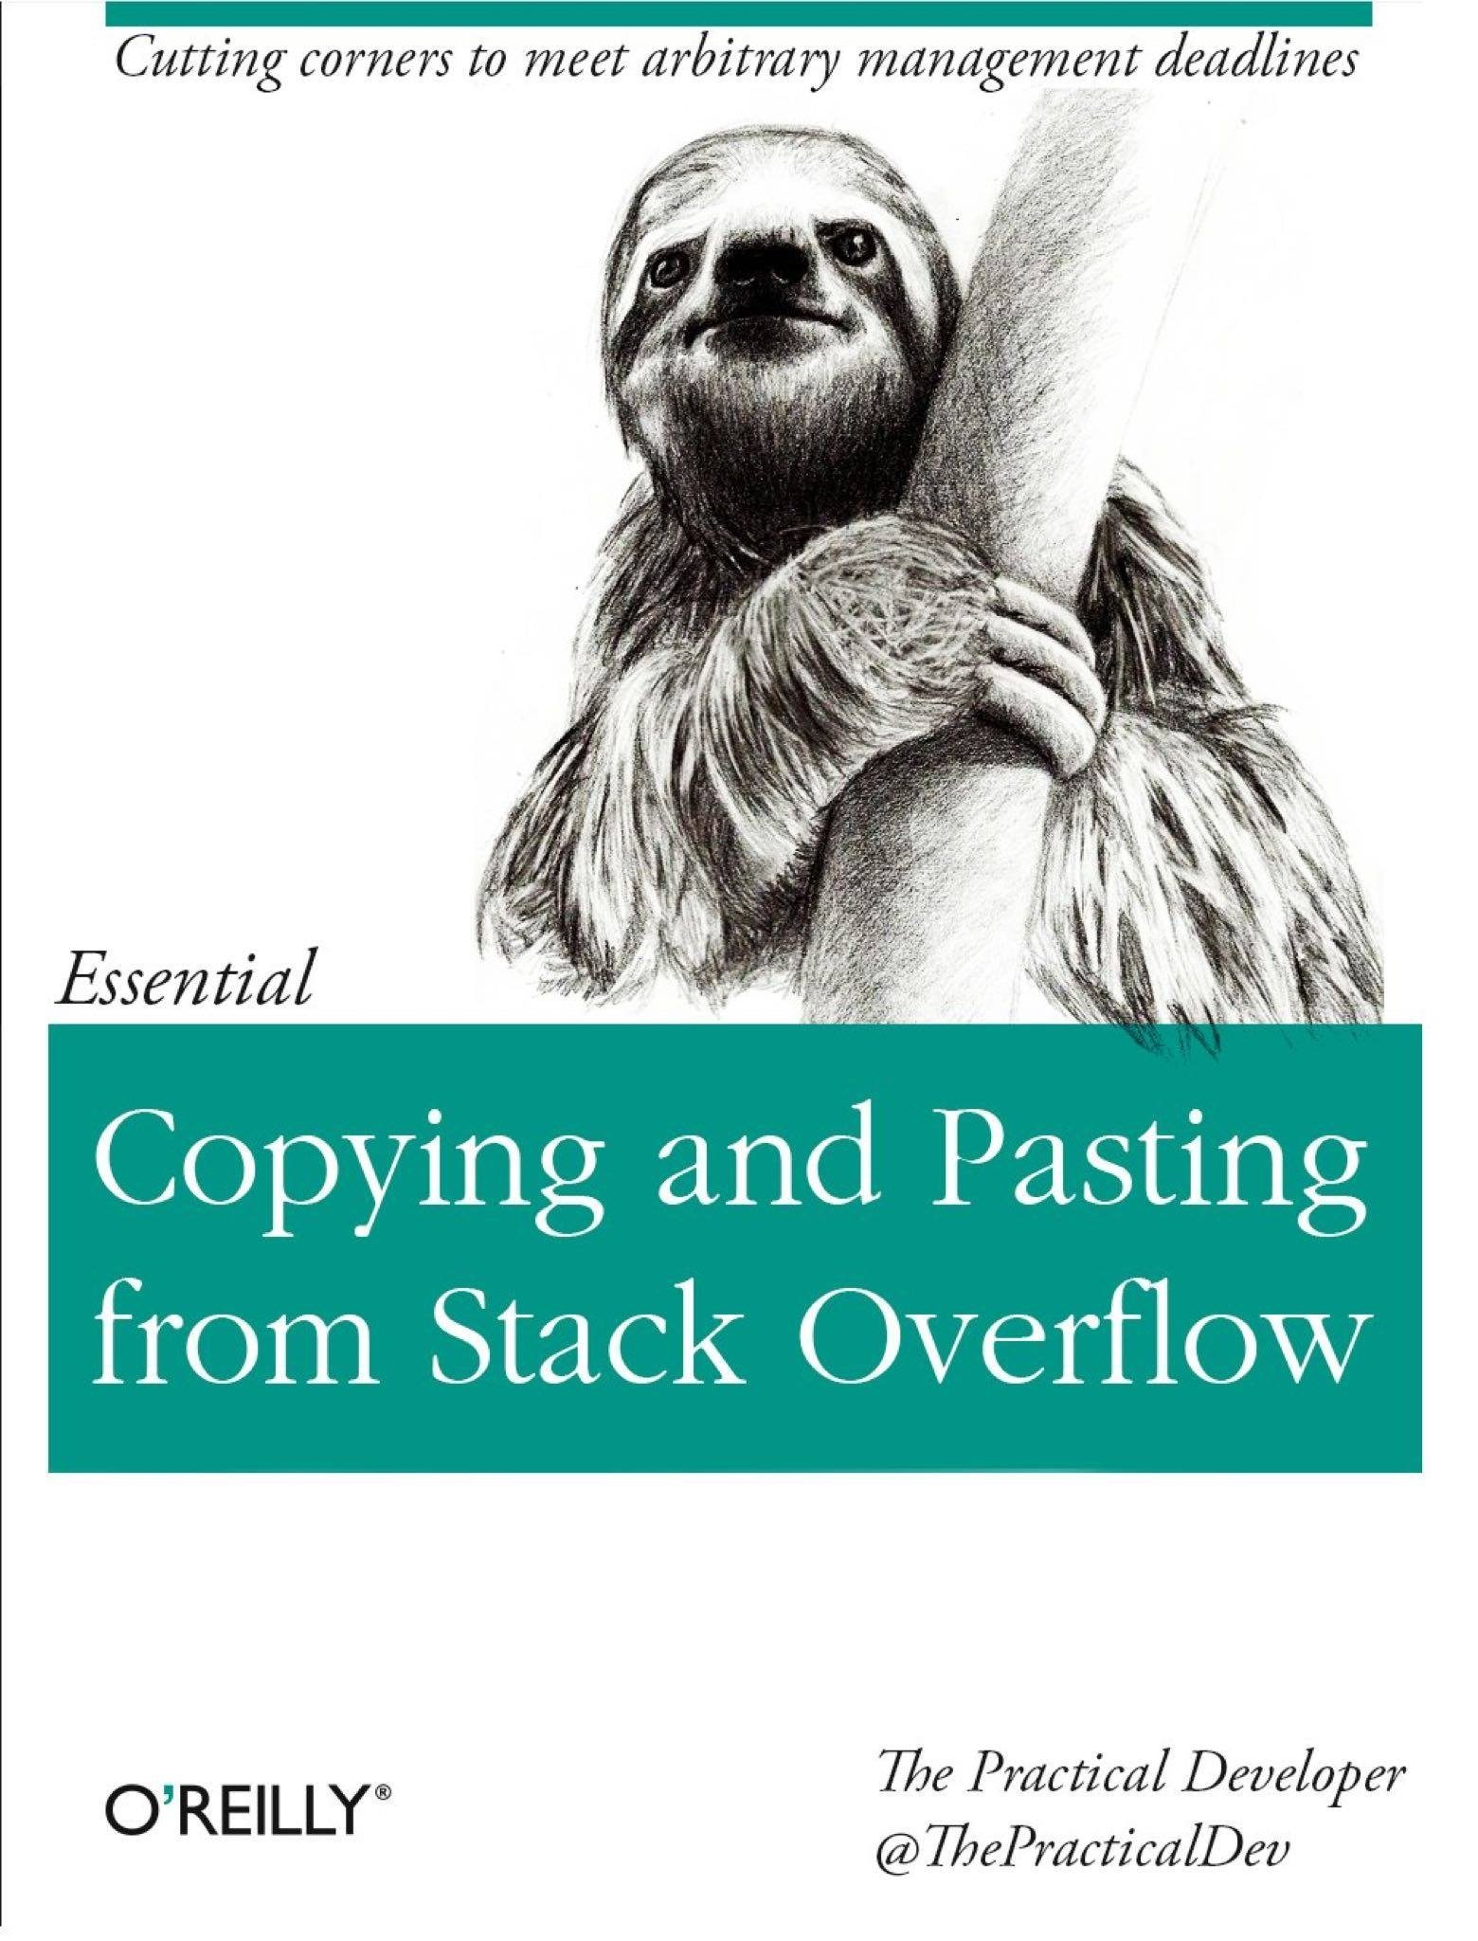
Essential reading

Slide 15
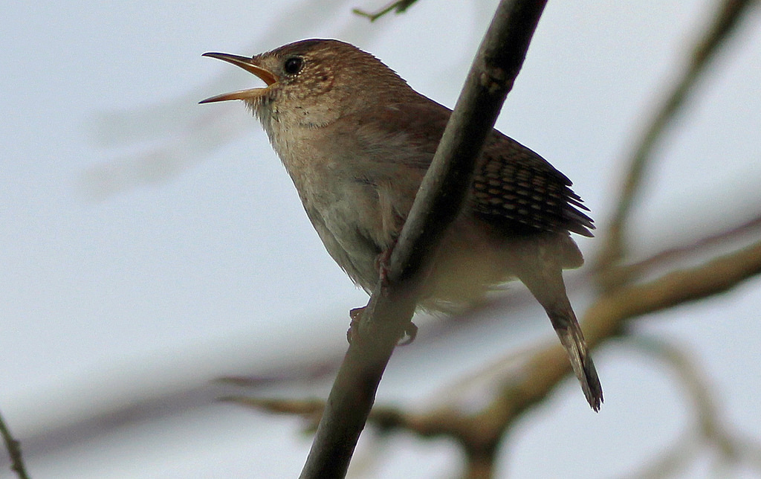
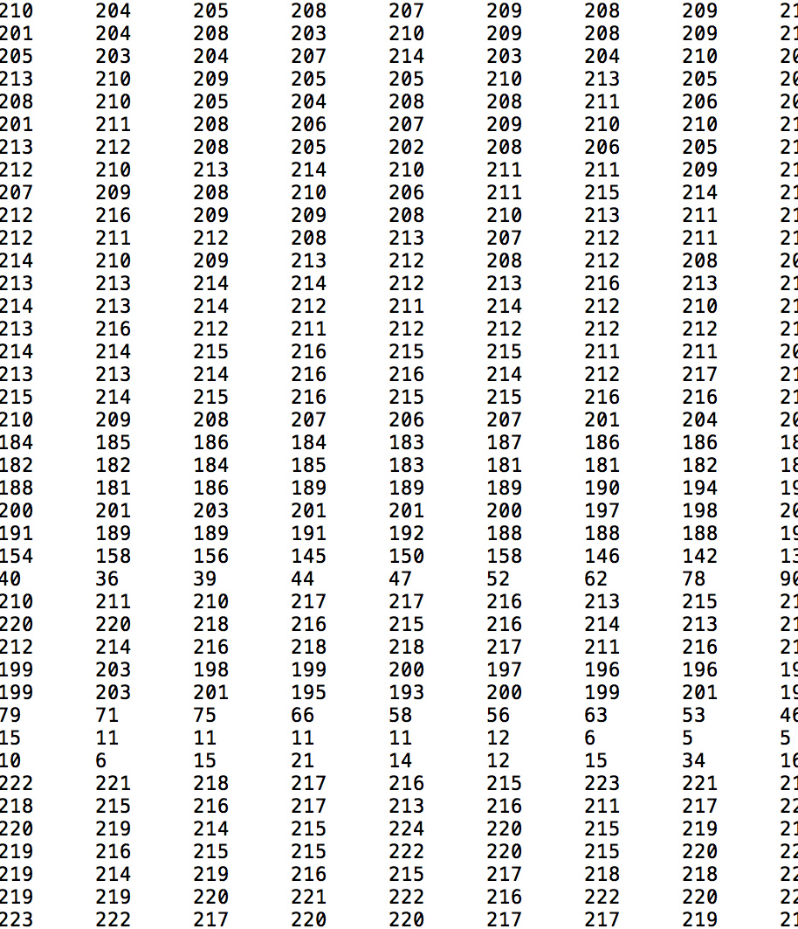
What are images?
Images are just arrays of numbers between 0 – 255 (or 0 – 1)
Each number is a pixel representing a color and its intensity

Slide 16
Python and images
Continues on:
notebooks/python_tutorial.ipynb

Slide 17
Deep Learning

Slide 18
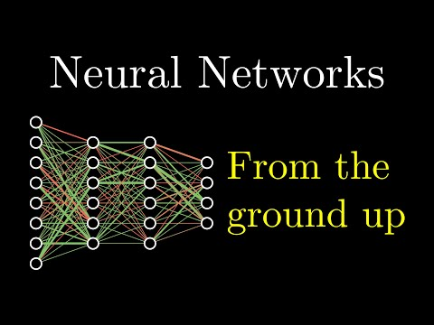
Neural networks
Attribution: https://www.youtube.com/watch?v=aircAruvnKk

Slide 19
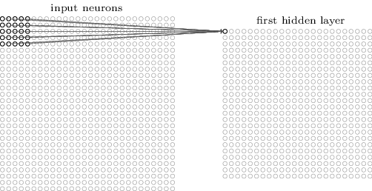
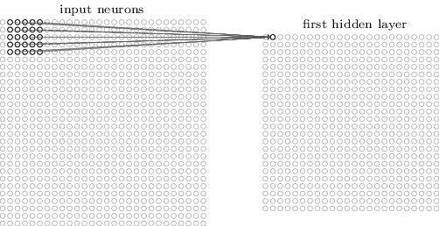
Convolutional neural networks (CNNs)
Attribution: http://neuralnetworksanddeeplearning.com/chap6.html

Slide 20
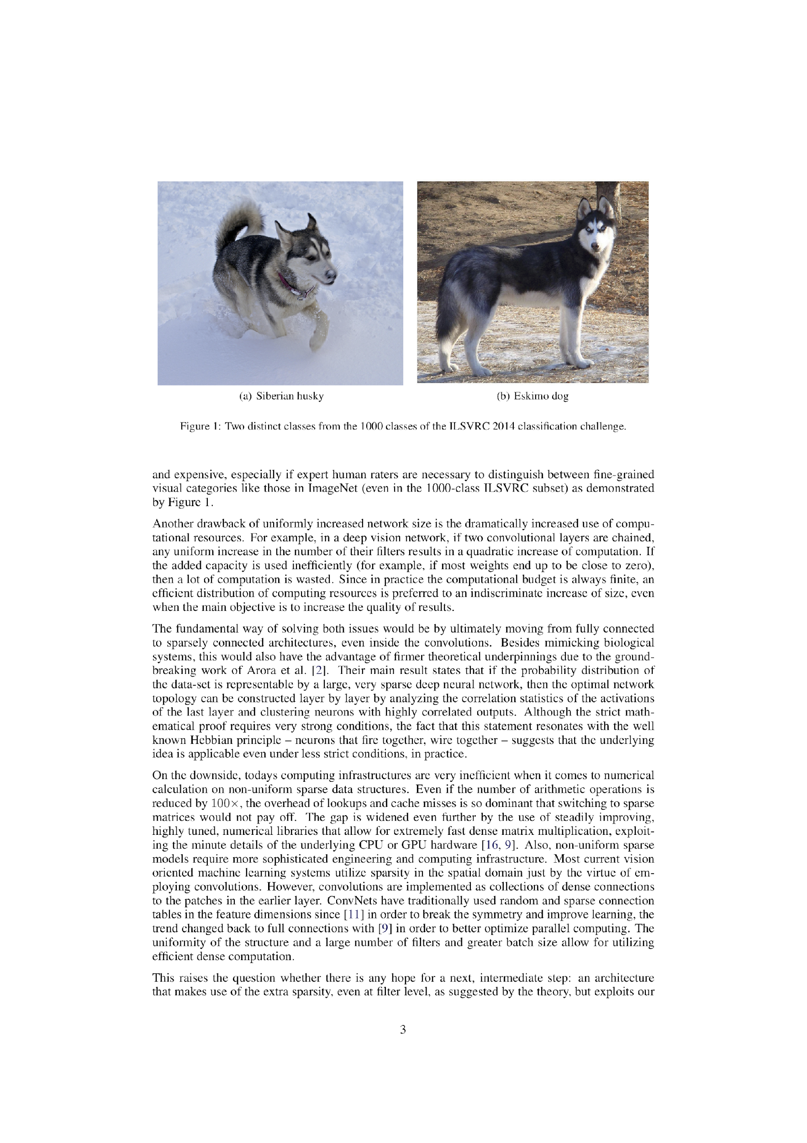
ImageNet Large-Scale Visual Recognition Challenge 2014
1000 categories
100,000 test images
GoogLeNet (Inception v1): 7% error
Human: approx. 5% error
Attribution: https://arxiv.org/abs/1409.4842

Slide 21
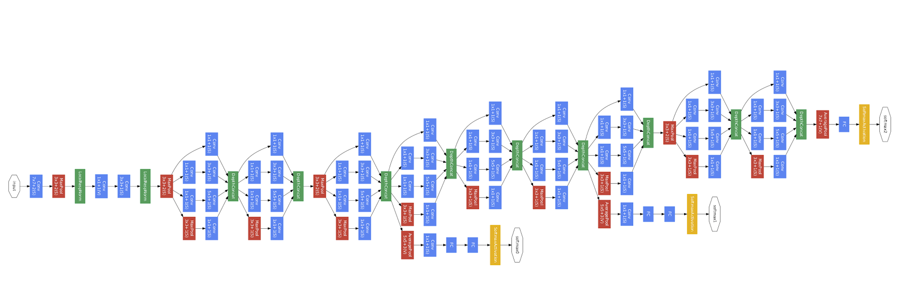
Inception v1 (GoogleLeNet)
Szegedy, C.; Liu, W.; Jia, Y.; Sermanet, P.; Reed, S.; Anguelov, D.; Erhan, D.; Vanhoucke, V.; and Rabinovich, A. 2015. Going deeper with convolutions. In Proceedings of the IEEE Conference on Computer Vision and Pattern Recognition, 1–9 10.1109/CVPR.2015.7298594

Slide 22
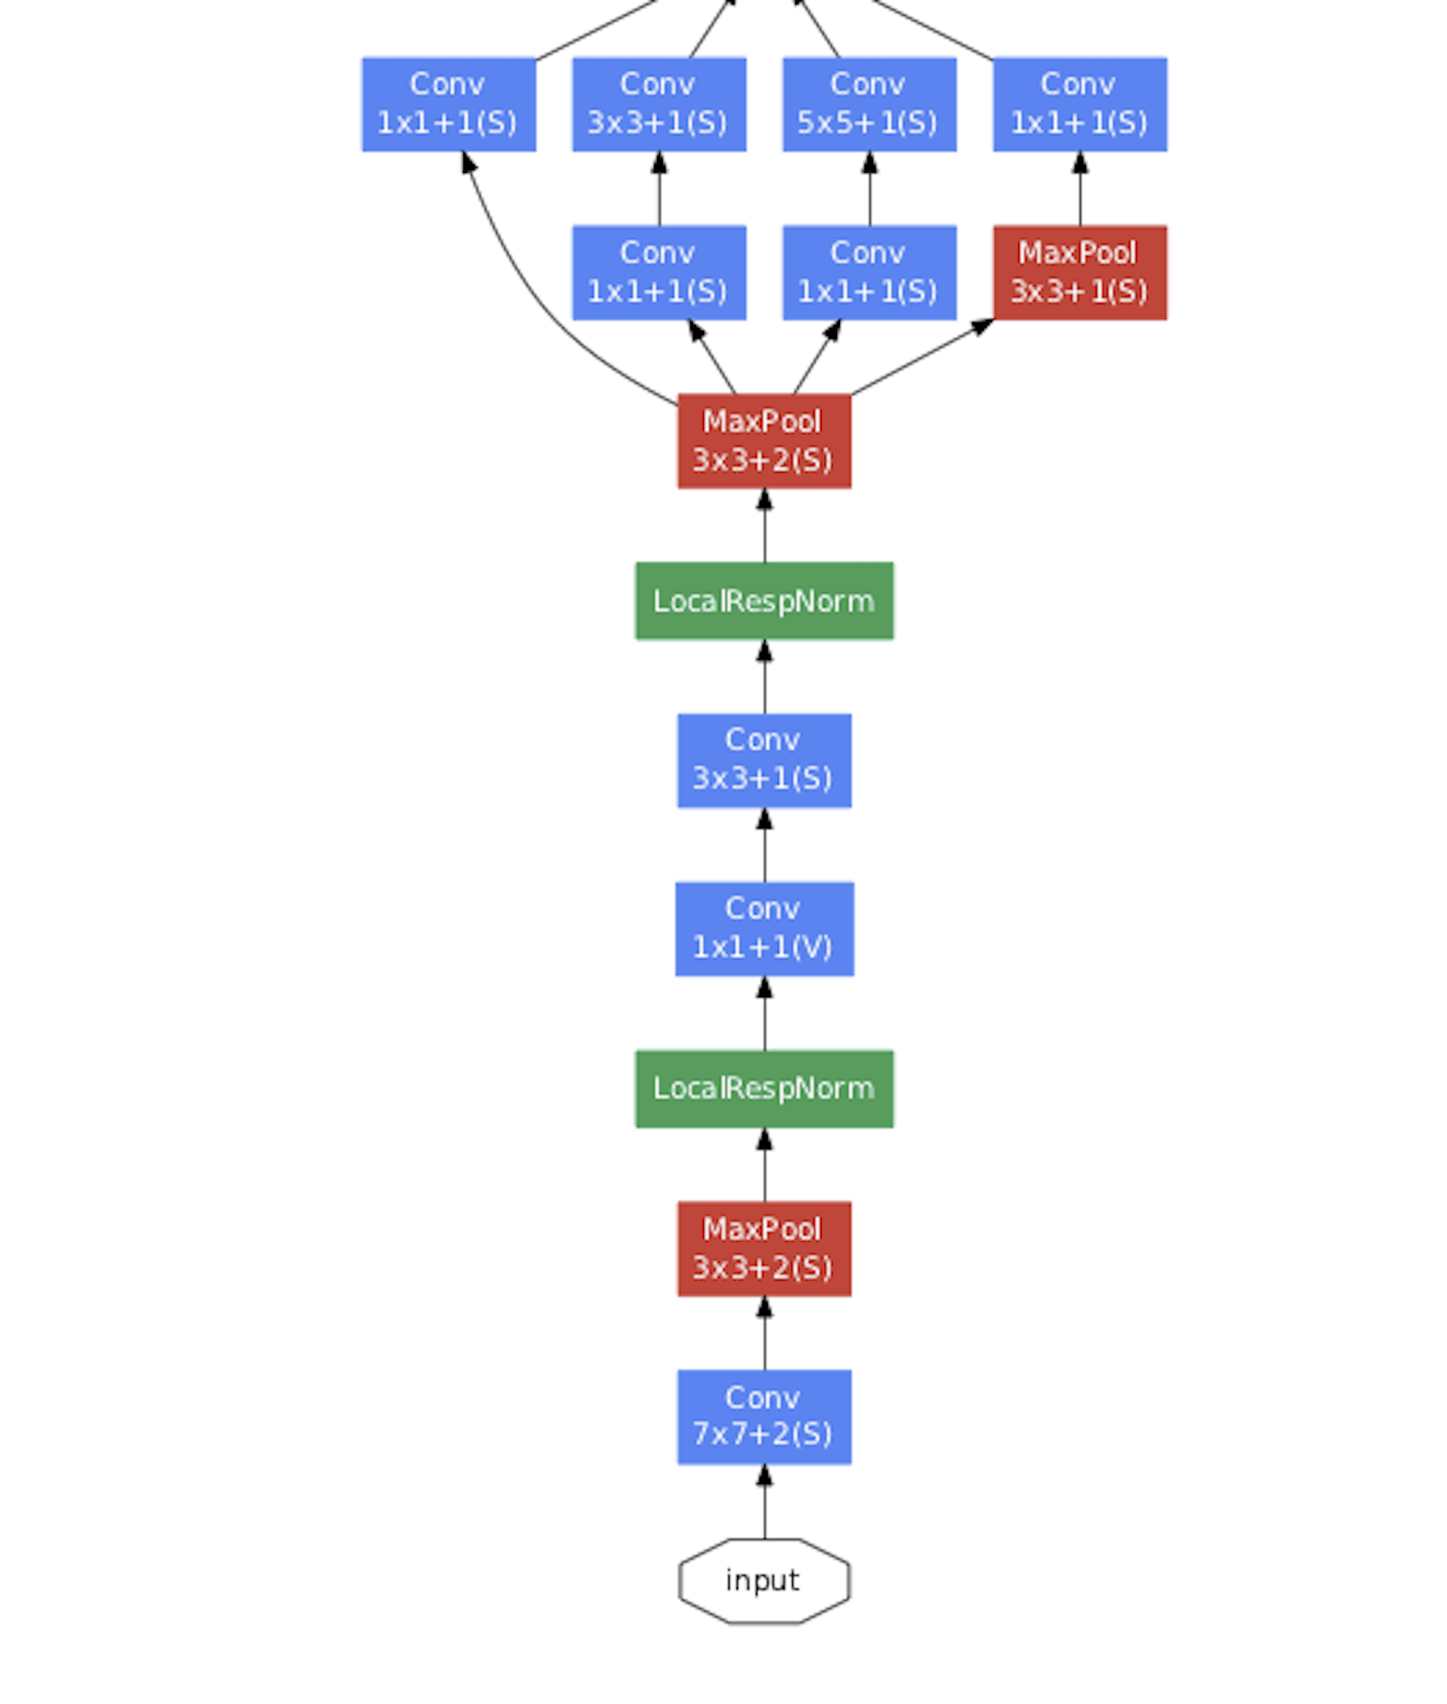
Inception v1

Slide 23
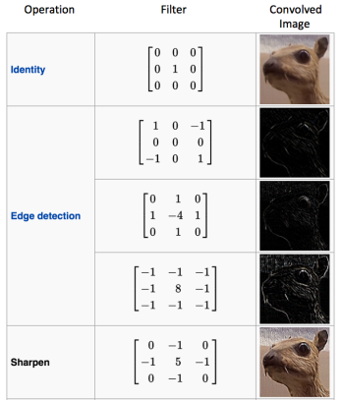
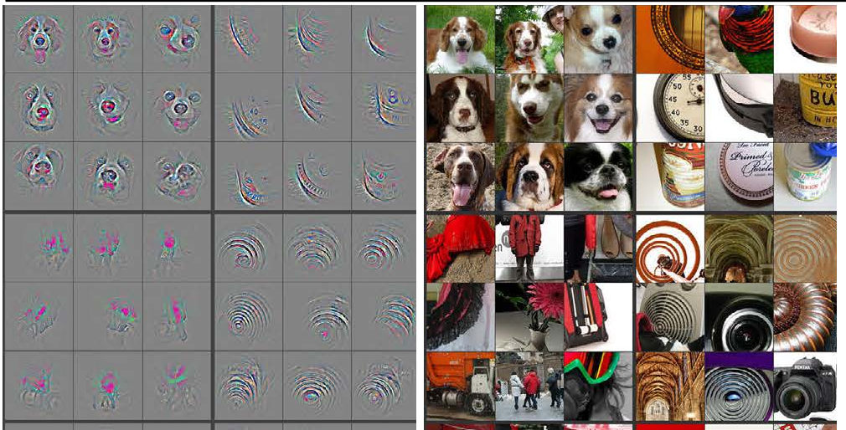
What do CNNs see?
https://medium.com/@RaghavPrabhu/understanding-of-convolutional-neural-network-cnn-deep-learning-99760835f148
https://jhui.github.io/2017/03/16/CNN-Convolutional-neural-network/

Slide 24
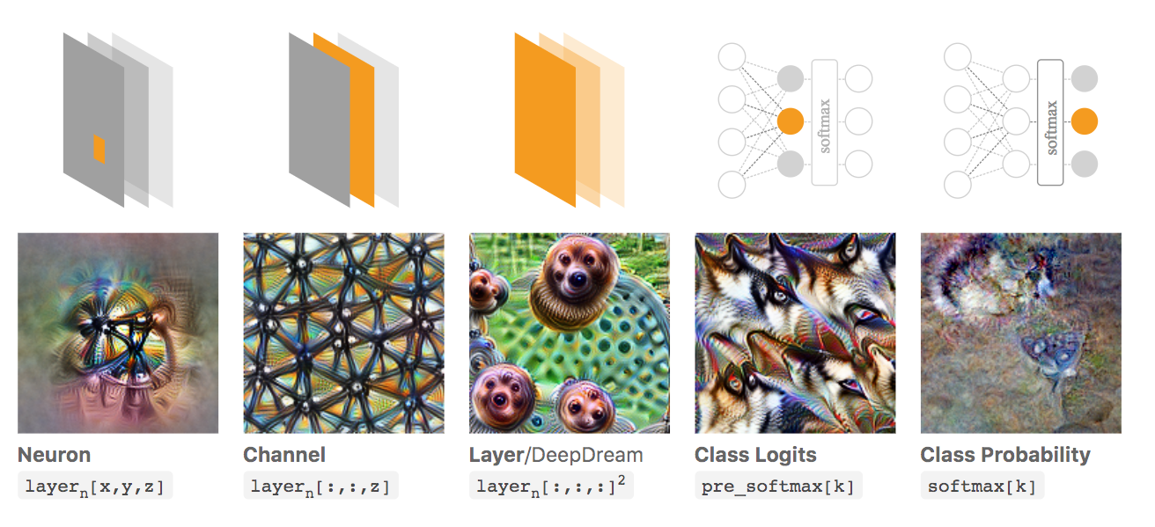
What makes CNNs ‘turn on’?
Attribution: https://distill.pub/2017/feature-visualization/

Slide 25
Style Transfer

Slide 26
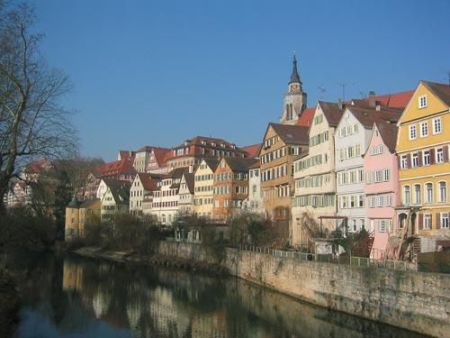
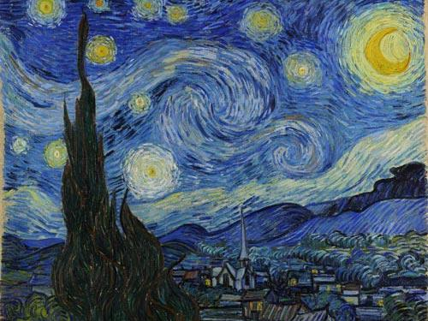
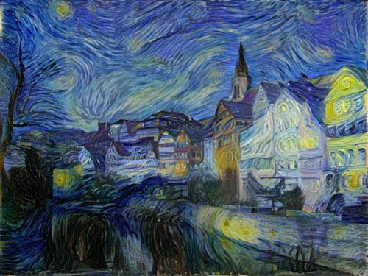
A neural algorithm of artistic style
https://deepart.io/
https://arxiv.org/abs/1508.06576

Slide 27
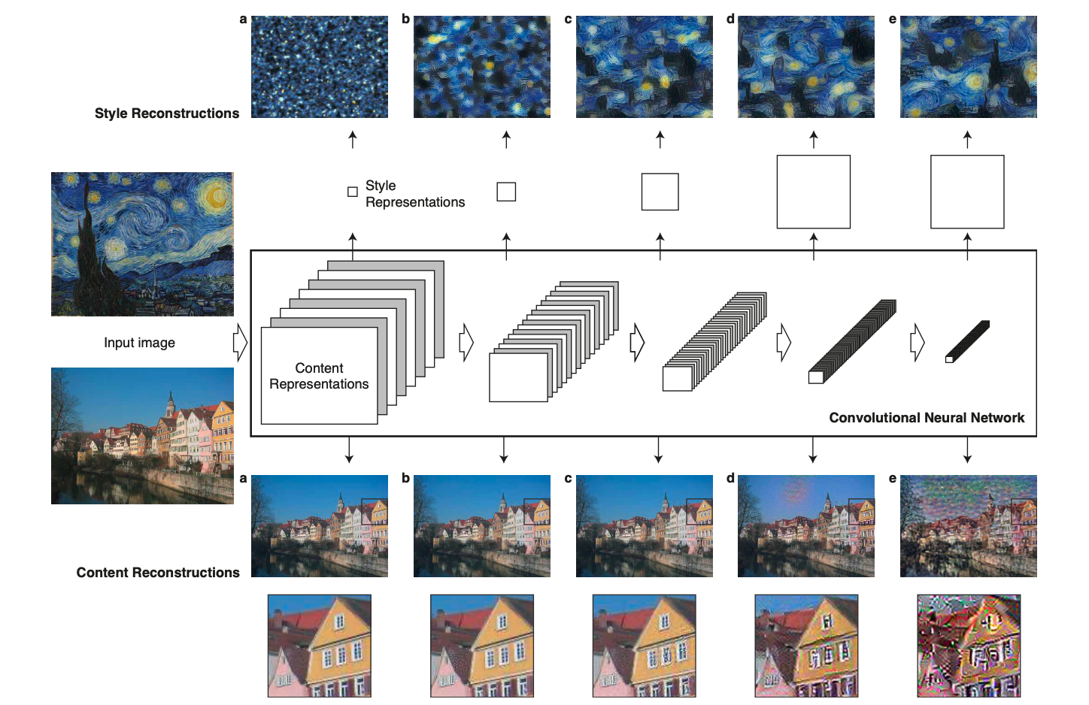
Style transfer
Gatys, L.A., Ecker, A.S., Bethge, M., 2016. Image style transfer using convolutional neural networks, in: The IEEE Conference on Computer Vision and Pattern Recognition (CVPR).

Slide 28
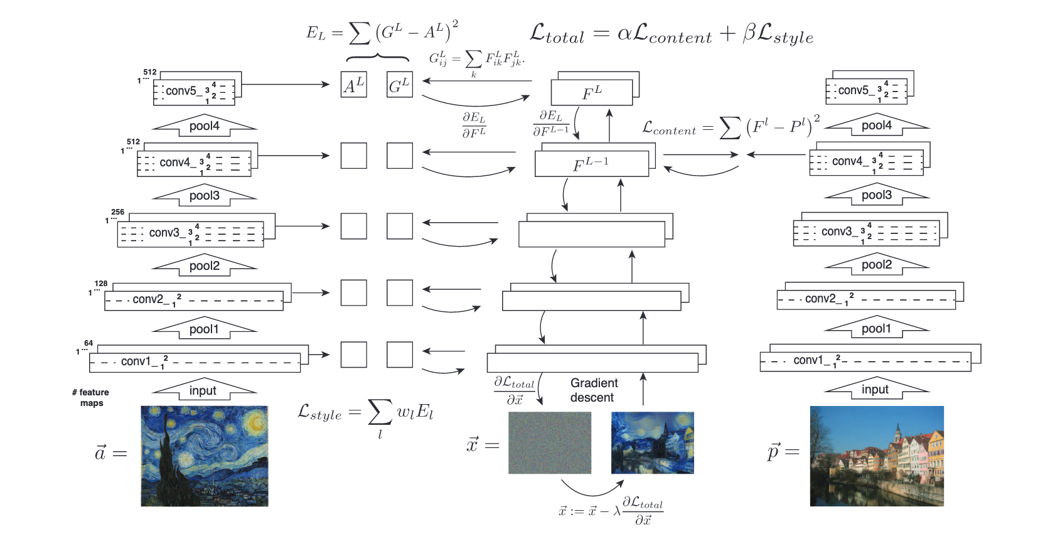

Slide 29
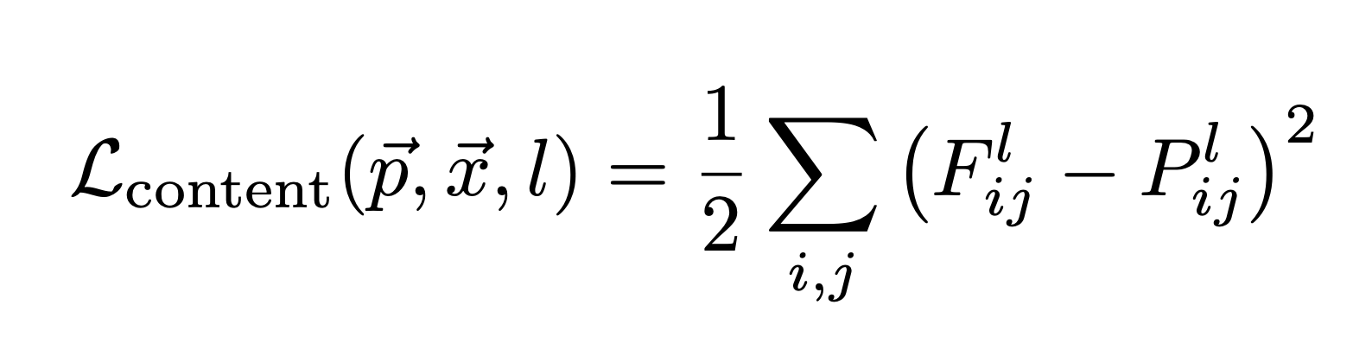
Content loss
target image
output matrix of layer ‘l’
content image
TOTAL CONTENT LOSS
content image: fixed
target image: changes

Slide 30
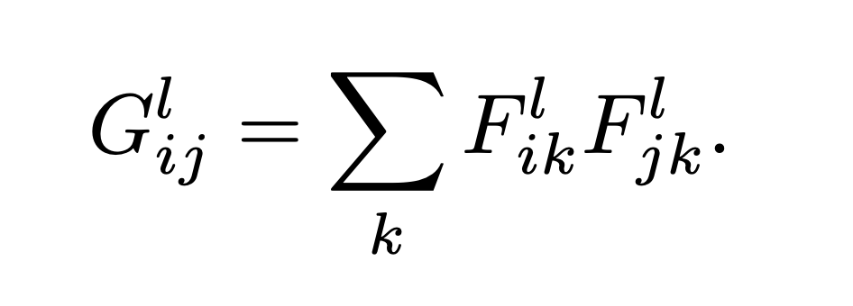
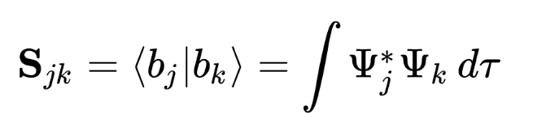
Style loss - Gram Matrix
output matrix of layer ‘l’
Quantum mechanical overlap matrix
Gram (overlap) matrix

Slide 31
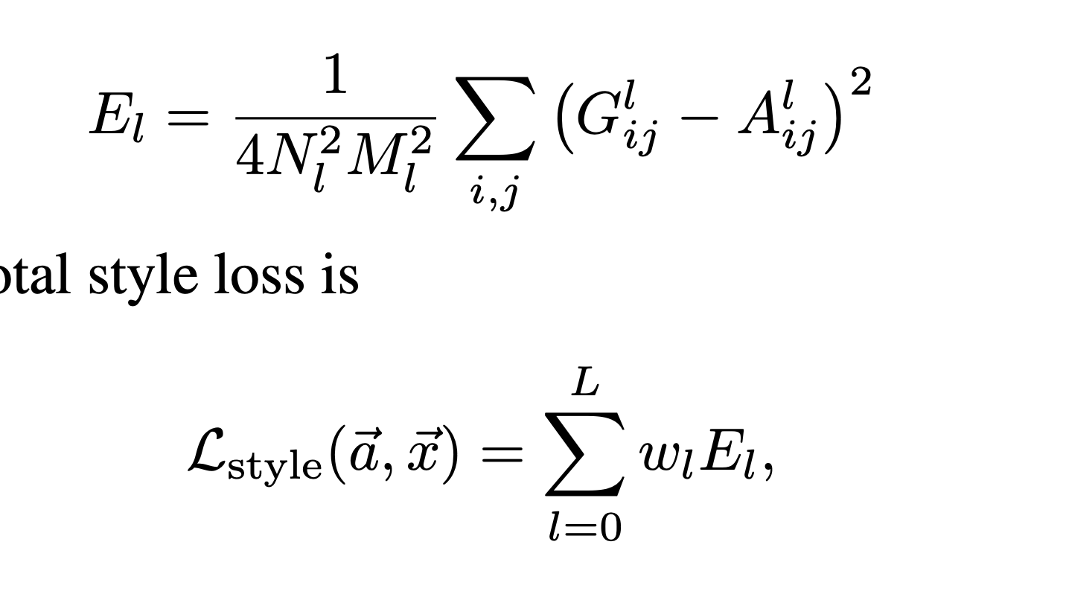
Style loss
Gram matrices at layer ‘l’
constant
style image: fixed
target image: changes
target image
sum over layers
weight of layer
style image
style loss from layer ‘l’
TOTAL STYLE LOSS

Slide 32
Creating the target image
CNN measures:
style(a)- style of style image, a
content(p)- content of content image, p
style(x),content(x)- style & content of target image, x
Change x to minimize:
ɑ[style(a)-style(x)]+β[content(p)-content(x)]
Relative weight of content/style: ɑ/β

Slide 33
What layers should I use?
Content:
Use a lower layer (doesn’t matter that much)
Style:
Lower layers pick out ‘small’ features
High layers pick out ‘large scale’ features
Create style fingerprint to find out
Combinations of layers work well

Slide 34
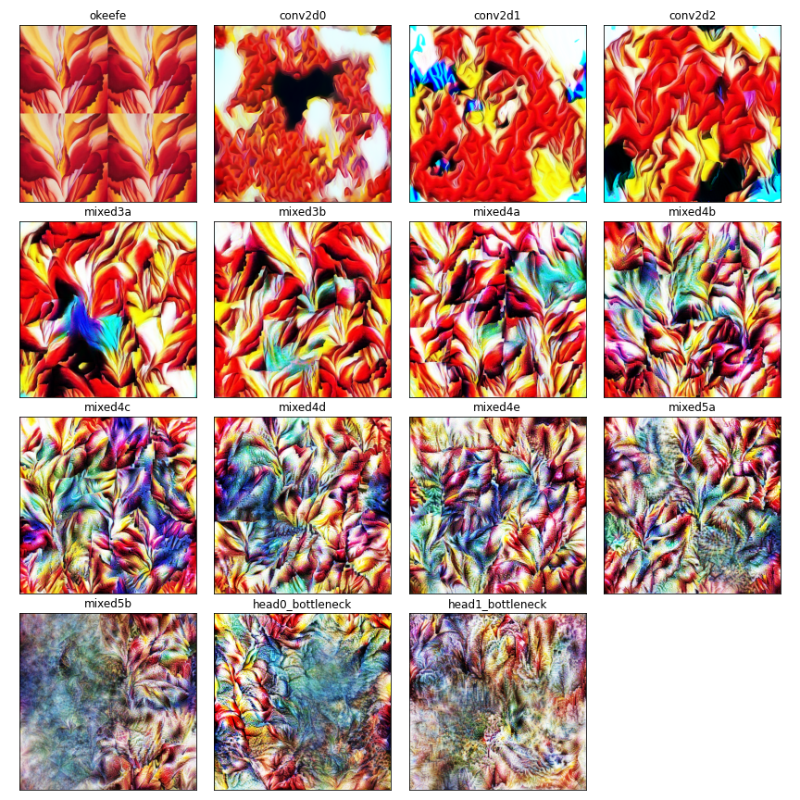
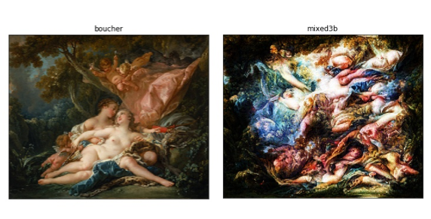
Style fingerprints

Slide 35
What images shall I use?
Content:
Use surfaces not cartoons/licorice
Color doesn’t matter
Use background color that be removed after
Style:
Works best with interesting textures
Tile images to pick up different ‘length-scale’ features.

Slide 36
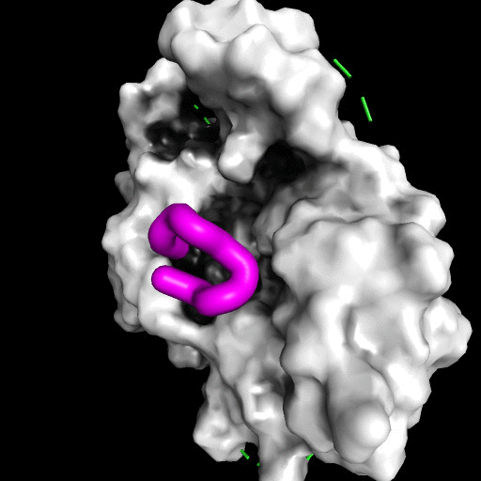
α4β2 nicotinic acetylcholine receptor
Simulations by Dr Sofia Oliveira
PDB code: 5KXI
https://asfosite.wordpress.com/
https://scholar.google.co.uk/citations?hl=en&user=oAtwCtQAAAAJ

Slide 37
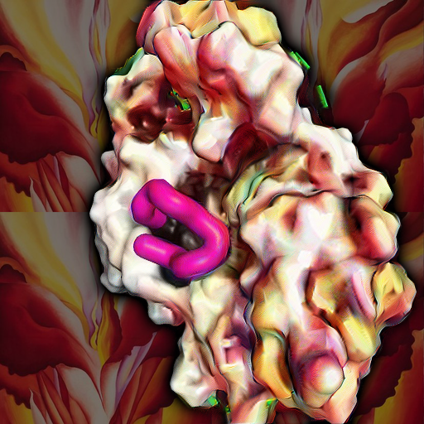

Slide 38
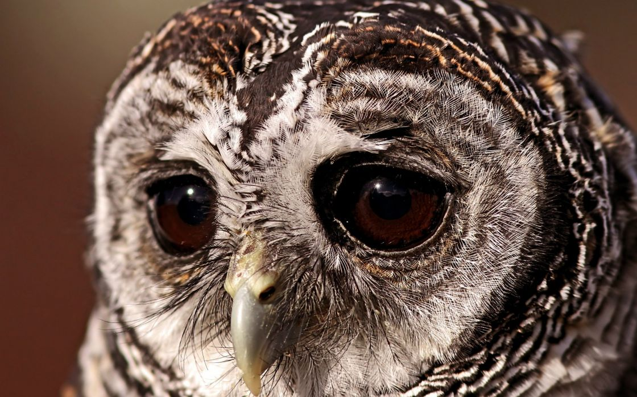
~Fin~

